Slide 1
Structures and Unions & Memory Allocation
Subject : COMP6047
ALGORITHM AND PROGRAMMING
Year : 2015

Slide 2
Learning Outcomes
At the end of this session, student will be able to:
Apply the concept of structure data type for various type of data (homogenous or heterogeneous) (LO3)

Slide 3
Sub Topics
Structures and Unions:
Structures
Union
Memory Allocation

Slide 4
Structure Definition
Structure is a data type to store group of data with various of data type
Structure component called member/field/element.
Heterogeneous (various element data type)
Structure in other programming language also called record

Slide 5
Structure Declaration
Syntax
struct name_structure {
dataType1 name_field1;
dataType2 name_field2;
…
};
Variable can be defined at declaration time
struct name_structure {
dataType1 name_field1;
dataType2 name_field2;
…
} name_variable_structure ;
Structure variable declaration
struct name_structure name_variable_structure;

Slide 6
Accessing Structure
Element (field) of a structure can be accessed using dot operator from structure variable
# include <stdio.h>
# include <string.h>
struct mhs {
char nim[9];
char name[26];
float gpa;
};
int main (){
struct mhs lia;
float wgpa;
scanf("%s", &lia.nim);
fflush(stdin);
gets(lia.name);
scanf("%f", &wgpa);
lia.gpa = wgpa;
printf("%s %s %.2f",
lia.nim, lia.name, lia.gpa);
return 1;
}

Slide 7
Local Structure
# include <stdio.h>
# include <math.h>
void main() {
struct {
int x, y;
} tA, tB;
float dist;
printf(“A position: \n ");
printf(“x and y position? ");
scanf("%d %d", &tA.x, &tA.y);
printf("\nB position : \n ");
printf(“x and y position? ");
scanf("%d %d", &tB.x, &tB.y);
dist = sqrt(pow((tA.x - tB.x), 2) +
pow((tA.y - tB.y), 2));
printf("\nDistance between A and B = %.2f unit", dist);
}
Output:
A position:
x and y position? 5 10
B position :
x and y position? 15 15
Distance between A and B = 11.18 unit

Slide 8
Nested Structure
Nested Structure is a structure with one of its element is another structure.
Structure as a member should be declared in advance.
Example:
struct mhs consists of nim, name, address, dob
address is a structure consists of name street, number, city, and province.
dob is a structure consists of date, month and year.

Slide 9
Structure Initialization
Syntax:
struct struct_name variable = {value_1, …, value_m};
Example:
struct account customer1 = {1984, ‘a’, “frenzy”, 200000, 19};
#include <stdio.h>
struct employee {
int id;
char name[32];
};
void main(void)
{
struct employee info = {1,"B. Smith"};
printf("name Employee: %s\n", info.name);
printf("ID Employee: %04d\n\n", info.id);
}

Slide 10
Array of Structure
Structure data type can only contain one record. Real world problem needs group of records.
In practice, structure usually used in conjunction with array.
struct Dob{
int date, month, year;
};
struct Account {
int accountNo;
char accountType;
char name[31];
long credit;
struct Dob lastTrans;
};
//Array of structure
struct Account customer[100];

Slide 11
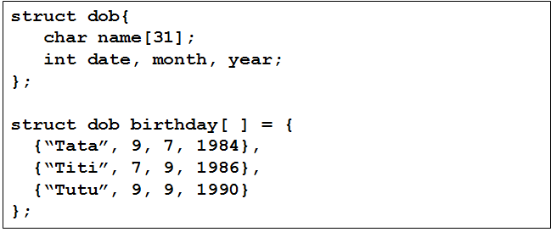
Array of Structure
Init Array of Structure

Slide 12
Array of Structure
int main (){
struct tmhs arr[50], x;
...
scanf("%s", &arr[0].nim);
...
x = arr[0];
arr[0] = arr[1];
arr[1] = x;
for (i = 0; i < 50; i++) {
printf("%s %s %.2f",
arr[i].nim, arr[i].name,
arr[i].gpa);
}
return 1;
}
Example:
# include <stdio.h>
# include <string.h>
struct tmhs {
char nim[9];
char name[26];
float gpa;
};

Slide 13
Typedef
typedef is an alias (other name)
Used for short naming – especially for long identifier
typedef commonly used in a structure
Example:
typedef struct BinusStudent{
char name[20];
int nim;
float gpa;
}Mhs;
Mhs is an alias name of struct BinusStudent, and its function as a new data type.
To define a structure variable, using:
Mhs ali, tono;

Slide 14
Typedef
Example:
#include <stdio.h>
#include <conio.h>
typedef struct Employee {
int id;
char name[32];
}EMP;
int main(void)
{
EMP info = {1,"B. Smith"};
printf(“Employee name: %s\n", info.name);
printf(“Employee ID: %04d\n\n", info.id);
getch();
return 0;
}

Slide 15
Bit Field
A struct with each element assign with certain number of bit.
Syntax:
struct name{
type field1: numberof_bit;
…...
};
Type : can only use unsigned int, signed int, or int.

Slide 16
Union Definition
Union is used for memory join. By using union, a memory location can be assigned for two or more variable with different data types
Memory capacity used by union is the largest capacity used by any element of the union

Slide 17
Union Declaration
Union Data Declaration
Union Variable Declaration
 | union name_union{ typedata1 name_var1 ; typedata2 name_var2; …… } name_var_union;
 | union name_union name_var_union;

Slide 18
Enumeration
Enumeration is a data type with predefined number of data. This limited number of data is named for program readability.
Data type enumeration declaration
enum name_type {
const1, const2,… const_n
}name_var;
Enumeration variable
enum name_type name_var;

Slide 19
Static Keyword
Keyword static can be used as variable type, or return value type of a function
Static variable:
Allocated at program start and de-allocated at the end of a program
Default value = 0
Scope of static variable is inside a file where the variable is defined
Syntax:
static type variable_name;
Example:
static int x;

Slide 20
Static Variable
Example:
#include <stdio.h>
void print()
{
static int count=0;
printf("count=%d\n",count++);
}
int main(void)
{
int i;
for(i=0; i<5; i++) print();
for(i=0; i<3; i++) print();
return 0;
}
Output:
count = 0
count = 1
count = 2
count = 3
count = 4
count = 5
count = 7

Slide 21
Register Variable
Objective: increase run time speed.
Defining a variable store in a register (if possible – register is limited). If rejected: automatic variable.
Syntax:
register data_type variable_name;
Example :
register int x;

Slide 22
External Variable
In a modular programming, a program is divided into modules. In C modules are implemented using function.
A module may consist of several functions. And save in a file.
If function in a particular file wants to access a variable in other file, then use keyword extern
Example :
extern int x;

Slide 23
Void * Data Type
Keyword void :
void main(void)
{
void *malloc(size_t size);
………
}
Function without actual parameter
Pointer that can point any data type
A void function

Slide 24
Const Char *
Comparing char * with const char * using strcpy
Example:
char *strcpy( char *strDestination, const char *strSource );
Description:
char * : should be a pointer (has an address)
const char * : can be string or pointer
Example:
char ss[20]; char str[20] = ”Good Morning”;
strcpy(ss,”Good Morning”);
strcpy(ss, str);
strcpy(”Hello”, ss); //error
Constant String

Slide 25
Memory Allocation
Memory allocation:
acquiring some memory space (RAM) managed by the OS to be used by a program.
Memory de-allocation:
releasing memory space (RAM) back to the OS.
int main() {
long nim;
float gpa;
...
}
nim is a variable, nim needs memory space as data store.
gpa is a variable, gpa needs memory as data store

Slide 26
Memory Allocation
Memory Allocation as a data store:
1. static
 can be assigned with name → variable
 allocated at compile time
 stored at local stack memory
 remain unchanged during the program run
 de-allocated when the program end
2. dynamic
 can be assigned with name
 allocated at run-time
 stored at heap memory
 can be de-allocated at any time

Slide 27
Array Memory Allocation
# include <stdio.h>
# include <stdlib.h>
int main() {
int *arr, n, i;
do {
fflush(stdin);
printf(“total element ? ");
scanf("%d", &n);
if (n == 0) break;
arr = (int *) malloc (n * sizeof(int));
printf(“Input %d numbers: ", n);
for (i = 0; i < n; i++) scanf(“%d", &arr[i]);
printf(“reversed: ");
for (i = n - 1; i >= 0; i--) printf("%d ", arr[i]);
printf("\n\n");
free(arr);
}while (1);
return 1;
}

Slide 28
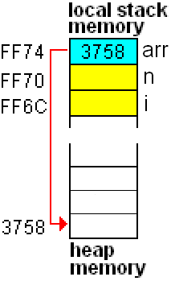
Array Dynamic Memory Allocation
int *arr;
printf(“total element ? ");
scanf("%d", &n);
arr = (int *) malloc (n * sizeof(int));
total element ? 3

Slide 29
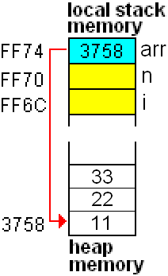
Array Dynamic Memory Allocation
printf(“Input %d numbers: ", n);
for (i = 0; i < n; i++) scanf("%d", &arr[i]);
printf(“reversed: ");
for (i = n - 1; i >= 0; i--) printf("%d ", arr[i]);
total element ? 3
Input 3 numbers: 11 22 33
reversed: 33 22 11

Slide 30
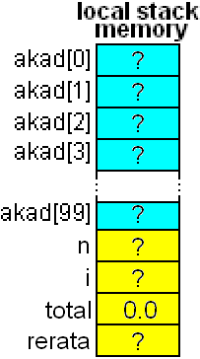
Array of Pointer of Dynamic Structure
# include <stdio.h>
# include <stdlib.h>
struct takad {
char nim[9];
float gpa;
} ;
int main() {
struct takad *akad[100];
int n, i;
float total = 0, rerata;
...
}

Slide 31
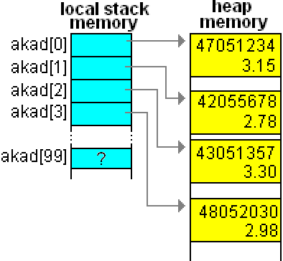
Array of Pointer of Dynamic Structure
akad[i]= (struct takad*) malloc(sizeof(struct takad));

Slide 32
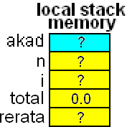
Pointer of Array of Dynamic Structure
# include <stdio.h>
# include <stdlib.h>
struct takad {
char nim[9];
float gpa;
} ;
int main() {
struct takad *akad;
int n, i;
float total = 0, rerata;

Slide 33
Pointer to Functions
Pointer to function is the address of a function in the memory
Syntax:
return_type (* pointer_name)(parameter);
Example:
int (*compare)(int a, int b);
note: compare is pointer to function name, pointing to a function that return integer value which has 2 integer parameters
Note the difference:
int compare (int a, int b);
Means: compare is a function name with integer return value that has 2 integer parameters

Slide 34
Summary
Structure is a data type to store group of data with various of data type
Structure in other programming language also called record
Nested Structure is a structure with one of its element is another structure.
Union is used for memory join. By using union, a memory location can be assigned for two or more variable with different data types

Slide 35
Summary
Memory allocation:
acquiring some memory space (RAM) managed by the OS to be used by a program
Memory de-allocation:
releasing memory space (RAM) back to the OS

Slide 36
References
Paul J. Dietel,Harvey M. Deitel,. 2010. C : how to program. PEAPH. New Jersey. ISBN:978-0-13-705966-9 Chapter 10
Collecting Data Items of Different Types: http://aelinik.free.fr/c/ch19.htm
Structs, Enums, and Unions: http://www.lysator.liu.se/c/c-faq/c-9.html

Slide 37
References
Paul J. Dietel,Harvey M. Deitel,. 2010. C : how to program. PEAPH. New Jersey. ISBN:978-0-13-705966-9 Chapter 2, 13 & 14
C - Storage Classes: http://www.tutorialspoint.com/cprogramming/c_storage_classes.htm
C Programming - Dynamic Memory allocation: http://www.exforsys.com/tutorials/c-language/dynamic-memory-allocation-in-c.html

Slide 38
END

